Slide 1
DAHEL PROJECT ON AMAZON PRIME SALES BY IVOKE CHINWENDU MABEL
INTRODUCTION
This project aims to analyze and boost amazon prime sales

Slide 2
BACKGROUND PROJECT
Amazon has been a significant market in sales industry, offering various helps to sellers and consumers alike. This is the reason i helped to analyze and give strategies that will help to increase sales in the competitive online market industry.

Slide 3
PROJECT OBJECTIVES
SALES OVERVIEW
Total sales revenue
Average rating
Total number of reviews
Sales by category
Sales overtime
PRODUCT PERFORMANCE
Top 10 best rated products
Top 10 most reviewed products
Products with low stock
Filter by brand, category and prime.
SELLER AND INVENTORY
Seller performance
Stock-level overview
Large vs non large product sales
Sales by delivery type

Slide 4
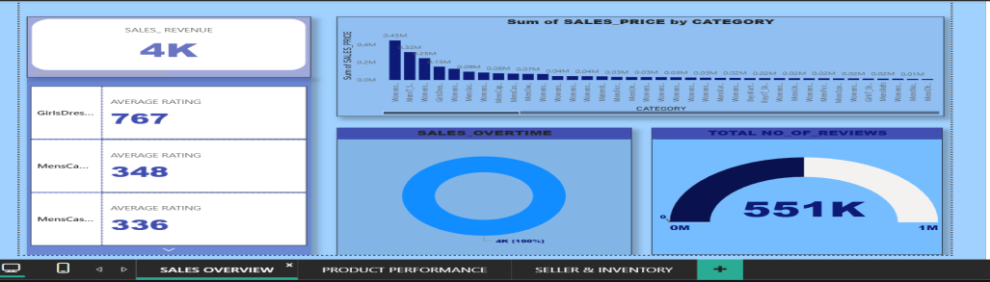
METHODOLOGY
DATA COLLECTION
I used Amazon prime sales data as market research and consumer feedback to gather comprehensive insights.
DATA ANALYSIS
SALES OVERVIEW
The above is the overview of sales.
Looking at sales base on category, it seems like consumers are not satisfied with some products leading to a significant decline in sales.
Some of their competitors offer better features and pricing, making it difficult for most of the products to stand out in the market.

Slide 5
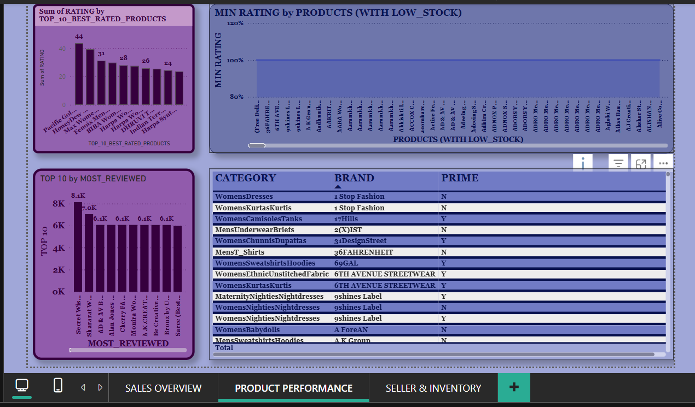
PRODUCT PERFORMANCE
Among the most reviewed, most of the products were seen on the same level of review of 6.1,while about two of the products had a slight increase in reviews.
The analysis showed a noticeable competition in the reviews and ratings.
The whole products experienced low stock I think because of the nonchallant behaviours of the sellers to restock.
The brands were shown base on its categories and prime.

Slide 6
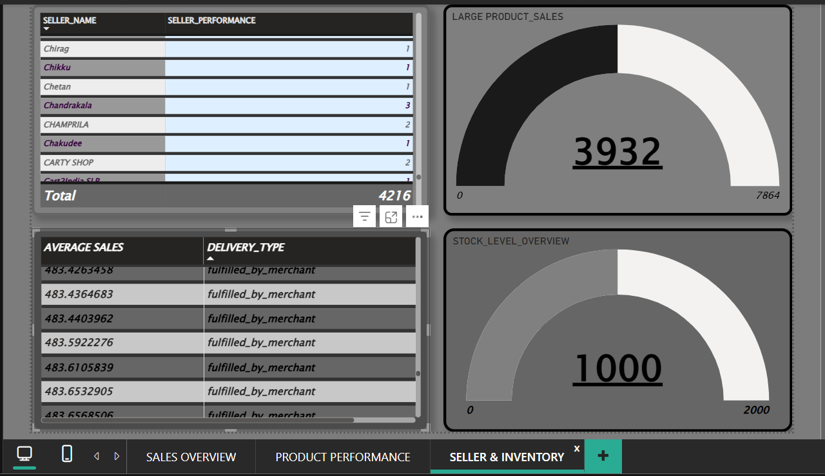
SELLERS PERFORMANCE The sellers made no satisfactory performances, they exceeded each other with a little percentage which is not a good result. Most of the sales were delivered by the merchants’ The large and non large sales were seen on the same ratio while the stock level was the same as the sold products.

Slide 7
VISUAL CHOICES AND RATIONALE
I used bar chart because I showed the distribution of data points and compared metric values across different groups of the given data. This will help to understand the data intuitively especially during comparison. The length of each bar directly corresponds to the data value, making comparisons easy at a glance.
I used the table chart inorder to present detailed and precise data in a structured format. It helped to show specific values and to make precise comparisons.
I also used a semi circle pie chart because it offers more space- efficient way to visualize part to whole relationships compared to a full pie chart.
It helped to compare two major categories(large and non large)while still representing 100% of the data.
It highlighted two main categories simplifying complex data into a concise visuals.
It also takes up less space which is beneficial to dashboards.

Slide 8
RECOMMENDATION AND CONCLUSION
RECOMMENDATIONS
Amazon should encourage sellers to pull in more reviews from satisfied customers.
They should also encourage sellers to always review their performances by analyzing their sales data to understand what worked and what didn’t.
Amazon should enforce use of data analysts by sellers to make smarter decisions. This will help them to track metrics and KPI’s such as conversion rates, profit margin. It will also help them to get real data that can inform business decisions and help sellers grow quickly and sustainably.
They should encourage brands to measure market share trends as a way to increase category growth in sustainable ways.
CONCLUSION
By recommending an innovative sales strategy, my goal is not only to boost sales but to establish a sustainable framework for continued growth and success of sales in Amazon.

